Slide 1
Facilities & Services
Strategic Planning Retreat
June 17, 2024

Slide 2
Purpose
To identify the general focus areas of the next strategic plan by reviewing where we are with the current strategic plan, the information we gathered from the surveys and strategic discussions.

Slide 3
Agenda
Status of the current strategic plan.
What did we learn from the surveys and strategic discussions?
Review Mission, Vision, Values, & Guiding Principles.
Other initiatives that will likely impact the new strategic plan.
How we plan to move forward/next steps

Slide 4
Let's Be Sure To . . .
Keep the focus high level and not get into the weeds by discussion specific goals and actions
Keep employees and customers in mind
Keep it simple

Slide 5
Strategic Planning Overview

Slide 6
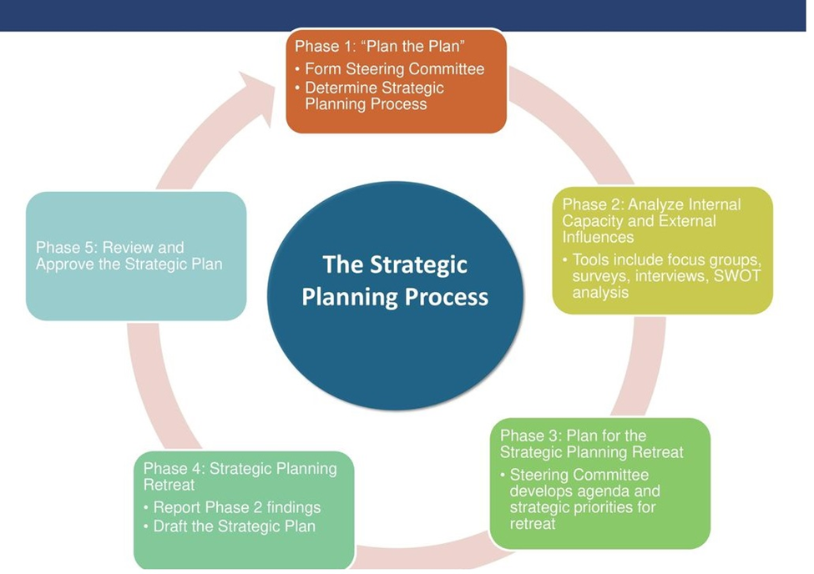
The Strategic Planning Process

Slide 7
What Was Our Focus?
What are we already committed to doing?
Where does the campus want to be in 5 years?
What do our customers want from us?
What do our employees want from us?

Slide 8
What Was Our Process?
Employee and customer surveys in 2023
Used information from surveys to conduct strategic discussions
Requested EMT submit responses to strategic discussion questions
Requested EMT review current strategic plan

Slide 9
Current Strategic Plan

Slide 10
Strategic Themes
People
Project Management
Customer & Stakeholder Relations and Communication
Financial Accounting
Safety & Environmental Protection
Deferred and Preventive Maintenance
Accessibility
Academic Collaboration
Space Management
Energy Management & Sustainability

Slide 11
People
P1: Develop staff: trained and continuous professional development, increase productivity and accountability
P2: Ensure staff are informed of all process and procedures and strategic initiatives
P3: Promote a diverse and inclusive workforce, with equal opportunity
P4: Value and respect all people; enhance an environment of a respectful workplace environment and culture
P5: Align/operationalize the workplace culture with our values
P6: Attract and retain high quality employees; talent acquisition
P7: Engage all employees in delivering quality results
P8: Promote an environment where employees are engaged with the community and contribute to outreach efforts

Slide 12
Project Management
PM1: Ensure timely communication
PM2: Complete 95% of the projects on time and on budget to satisfy our customer(s); set expectations, and reinforce accountability to achieve them; and manage expectations, defend the flag
PM3: Develop risk management intelligence
PM4: Simplify project delivery and workflow process
PM5: Develop standardized reporting mechanism on a regular basis

Slide 13
Customer & Stakeholder Relations and Communication
C1: Identify all Stakeholders associated with the work
C2: Increase more participation from underrepresented vendors and contractors
C3: Enhance relationships with vendors and contractor
C4: Provide opportunities for customers to provide feedback and get a response
C5: Ensure that all Facilities initiatives are communicated campus- wide; Build and enhance customer relationships and raise the awareness of F&S services and programs
C6: Ensure that university initiatives managed by F&S are communicated campus-wide.
C7: Enhance public engagement; implement public education and awareness programs
C8: Communicate F&S service levels campus-wide.

Slide 14
Financial Accounting
F1: Develop and adhere to operating budgets
F2: Develop and analyze rate structures for services
F3: Produce key performance indicators and benchmark against our peers
F4: Explore opportunities for grants, rebates and revenue generation
F5: Explore synergies/partnership opportunities for cost savings
F6: Improve operating efficiencies and effectiveness.

Slide 15
Safety & Environmental Protection
S1: Properly train employees
S2: Ensure current safety manuals, training, safe work practices are in place
S3: Identify and comply with Federal, State, and Local requirements that apply to campus operations and personnel.
S4: Reduce, minimize injuries, lost time, and worker's compensation
S5: Enhance, enforce and encourage a safe culture

Slide 16
Deferred & Preventive Maintenance
D1: Update the facility conditions assessment at the University of Illinois, Urbana-Champaign
D2: Develop a plan to regularly and continuously update the facility conditions assessment, based on D1.
D3: Develop a long-term Asset Management Plan (AMP)
D4: Establish a comprehensive PM plan for buildings, utilities, transportation, and the outdoor campus environment.

Slide 17
Accessibility
A1: Develop an understanding of building accessibility barriers on campus
A2: Further the commitment to ADA compliance and leadership in Accessibility
A3: Improve accessibility of campus walkways

Slide 18
Academic Collaboration
AC1: Contribute significantly to the research and teaching mission of the university
1. F&S professionals will contribute their industrial expertise & data to research projects, as lecturers or at special events 2. F&S will make their data available as required by researchers for data analytics and inferences purposes 3. F&S will accommodate efforts and make campus facilities available as Living Labs for research and educational purposes 4. F&S will provide tours for classes and special events

Slide 19
Space Management
SM1: Optimize Space Utilization
1. Work with the campus community to produce space allocation ratio per student by space type (lab, classroom, etc.) 2. Work with campus to develop space allocation matrix per FTE for every college. 3. Survey space utilization per use type 4. Develop improved utilization plan for underutilized spaces; work with Provost to strategize a workable plan for improved utilization of underutilized space by the middle of 2020. 5. Develop a Space Management Plan; Work with Provost to accurately record campus space and measure against space bank with searchable data in place by July 2019. 6. Maintain building demolition plan. Work with Facility Planning Committee in 2019 to prioritize future demolitions and incorporate demolition plan into Space Management Plan report to be done by December 2020.

Slide 20
Energy Management & Sustainability
E1: Develop Energy Conservation Plan
E2: Reduce energy consumption
E3: Increase renewable energy
E4: Reduce Water consumption
E5: Reduce vehicle emissions and fuel consumption
E6: Reduce non-point source pollutants from campus landscapes
E7: Reduce waste going to landfill
E8: Increase use of environmentally friendly procurement
E9: Decrease vehicles on campus
E10: Enhance sustainable landscapes
E11: Provide reliable, cost effective, and environmentally responsible utility service to campus

Slide 21
Survey & Strategic Discussions

Slide 22
Executive Summary: Employees
Key Areas
Staffing
Vision
Professional Development
Accountability
Culture
Systems

Slide 23
Staffing and Resources
Need for More Staffing and Competitive Salaries
Increased in-house Work Capabilities
Support from HR for Supervisory Decisions

Slide 24
Vision and Future Changes
Proactive Operations and Better Customer Relations
Efficient Workflows and Automation by 2029
Emphasis on Teamwork

Slide 25
Professional Development
Cost Barriers to Accessing Opportunities
More Development Opportunities
  Interaction within F&S
  Tech Classes
  Targeted Training by Supervisors

Slide 26
Accountability
Consistent Rule Enforcement Needed
Improved Project Completion Times
Systems to Measure Success and Celebrate Wins

Slide 27
Inclusive Workplace Culture
Better Communication and Transparency
Engagement Activities: Shop Tours, Kids' Day, etc.
Ongoing inclusion and diversity initiatives

Slide 28
Processes and Systems
Consistent Work-from-Home Policies
Compatible Software to Reduce Redundancy
Update Mobile Timekeeping Systems
Continued Training on Procedures and Policies

Slide 29
Collaboration
Importance of teamwork and accountability
Providing consistent exceptional service to campus
Need for open-minded supervision

Slide 30
Executive Summary: Stakeholders
Key Areas
Aligning Services and Future Needs
Transparency and Accountability
Improving Customer Experience
Staffing, Compensation, and Resources
Maintenance and New Technologies
Work Order and Project Management

Slide 31
Aligning Services and Future Needs
Continue to communicate initiatives with campus administrators
Hold meetings regularly regarding initiatives
Provide measurement and/or evaluation tools
Adopt proactive approach to unit needs

Slide 32
Transparency and Accountability
Improve transparency in project time and cost
Improve transparency in planning

Slide 33
Improving Customer Experience
Frontline staff and managers should show a commitment to improving customer experience
Better communication between shops
Point of leadership/contact
Regular meetings with customers
Service Level Agreements

Slide 34
Staffing, Compensation, and Resources
Proper compensation to retain staff
Services affected due to staffing/compensation
Increase staff to keep buildings clean
Increase F&S resources to give campus more resources

Slide 35
Maintenance and New Technologies
New Buildings vs. Current Buildings
Plan to maintain both new and current
Complete deferred maintenance
New technologies require ongoing trainings for both F&S and units

Slide 36
Work Order and Project Management
Work order details missed
Improve work order closeouts
Align service prioritization with customer needs
Detailed invoicing
Price schedule outlining common job costs

Slide 37
EMT Results
Service Alignment and Coordination: Enhance coordination with academic programs by designating a single point of contact and improving overall communication and processes to align with the university's mission.
Future Resource Needs: Address the need for better project management resources, additional administrative support, and an updated payroll system to meet future demands.

Slide 38
EMT Results
Improving Customer Experience: Strengthen communication skills among managers and frontline staff, focus on prioritizing customer-facing services, and reduce internal redundancies.
Operational Efficiency: Invest in professional development, cohesive departmental workspaces, and efficient resource allocation to boost team cohesion and productivity.

Slide 39
EMT Results
Vision and Accountability: Promote sustainability initiatives, secure funding for carbon-neutral projects, clearly define and enforce accountability measures, and foster an inclusive workplace culture through open discussions and respectful treatment of employees.

Slide 40
Themes
Discussion

Slide 41
Strategic Themes
People
Project Management
Customer & Stakeholder Relations and Communication
Financial Accounting
Safety & Environmental Protection
Deferred and Preventive Maintenance
Accessibility
Academic Collaboration
Space Management
Energy Management & Sustainability

Slide 42
What Themes Should We Keep?

Slide 43
Mission, Vision, Values, &
Guiding Principles

Slide 44
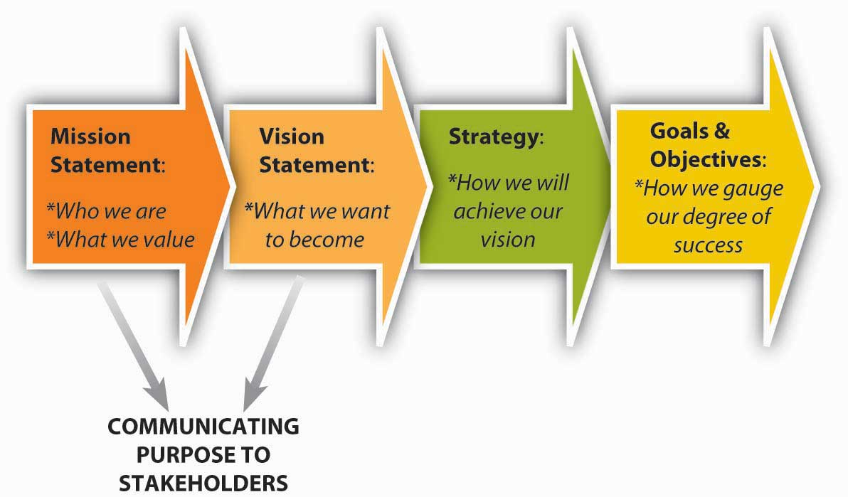
How Mission & Vision Inform Strategy
Source:4.3 The Roles of Mission, Vision, and Values – Principles of Management (umn.edu)

Slide 45
Defining Mission and Vision
Mission statements communicate the organization's reason for existing and how it will serve its stakeholders (employees, customers).
Vision statements are future oriented and communicate what the organization aspires to be.

Slide 46
Our Mission
Facilities & Services provides and maintains a physical environment that is conducive to supporting learning, discovery, engagement, and economic development at the University of Illinois and is an active partner in research, teaching, and learning.

Slide 47
Our Vision
We will be a responsive, reliable, and highly valued service provider.

Slide 48
Our Values (TRAITS-P)
TRUST: We will believe in the best of everyone and treat others as we would like to be treated.
RESPECT: We will value our employee and foster a work environment that promotes respect, dignity, and the worth of each individual.
ACCOUNTABILITY: We will be accountable for our actions and good stewards of our resources.
INTEGRITY: We will be honest, don what is right, and keep promises.

Slide 49
Our Values (continued)
TEAMWORK: We will work together to achieve common goals.
SAFETY: We will work to ensure the health and welfare of our employees, customers, and the community.
PERSEVERANCE: We will personally demonstrate dedication, tenacity, and endurance in accomplishing our work for the university.

Slide 50
Guiding Principles
CUSTOMER FOCUS: We will develop relationships with our customers built on trust, confidence, and reliability.
DIVERSITY: We will have a diverse workforce in an inclusive workplace that unleashes the talents of employees to create value, deliver superior support, and develop innovative solutions for the customers we serve. We will treat our co-workers and customers in a manner that encourages and strengthens an environment of inclusivity.

Slide 51
Guiding Principles
ENVIRONMENTAL STEWARDSHIP: We will demonstrate a commitment to health and sustainability in our stewardship of the campus environment.
INNOVATION: We will continuously strive to create new and innovative solutions that bring greater value to the customers we serve.
OPERATIONAL EXCELLENCE: We will empower our employees to deliver the greatest value to our customers in the most efficient and cost effective manner.

Slide 52
For Discussion
Does the current mission statement describe why we exist?
Does the current vision statement tell our stakeholders what we aspire to be?
What suggestions would you make to improve the statements (if any)?

Slide 53
Sample Mission Statement
Our mission is to ensure the efficient operation, safety, and functionality of our organization’s physical infrastructure. We strive to maintain high-quality facilities, provide responsive maintenance services, and promote sustainability. By fostering a collaborative environment, we aim to enhance the overall experience for our employees, visitors, and stakeholders.
Source: CoPilot

Slide 54
Sample Vision Statement
Our vision is to be a proactive and innovative team that ensures the seamless operation and sustainability of our facilities. We strive to create safe, efficient, and comfortable spaces that enhance productivity, foster collaboration, and reflect our organization’s commitment to excellence.
Source: CoPilot

Slide 55
University & System
Strategic Planning Alignment

Slide 56
Boldly Illinois: 2030 Strategic Plan
Goal 1
Foster Scholarship, Discovery, and Innovation
Scholarship, discovery, and innovation are at the heart of Illinois’ local, national, and global impact. We will drive new frontiers by attracting and retaining a diverse group of faculty, students, and staff endowed with creativity and intellectual depth and breadth. Modern infrastructures, streamlined processes, and enriching interdisciplinary and convergent work will advance the university’s mission.

Slide 57
Boldly Illinois: 2030 Strategic Plan
Goal 2
Provide Transformative Learning Experiences
With a solid academic core, Illinois will deliver on the fundamental promise of a public university—to teach students and to pioneer the science and the art of learning. This is transformative knowledge—for the individual and, collectively, for the world in which we live and work.

Slide 58
Boldly Illinois: 2030 Strategic Plan
Goal 3
Make a Significant and Visible Societal Impact
When the core foundations of unabashed discovery combine with transformative learning and teaching, the outcomes are no longer measured simply in degrees or in citations. They are seen in how the world is changed for the better through contact with the University of Illinois at Urbana-Champaign. The university lives up to its land-grant mission in many ways, and we will better organize, enrich, and value these contributions as we reach out to our local, regional, national, and global communities.

Slide 59
Boldly Illinois: 2030 Strategic Plan
Goal 4
Steward Current Resources and Generate Additional Resources for Strategic Initiatives
The University of Illinois at Urbana-Champaign has stewarded its land-grant mission and accompanying financial, human, technology, and infrastructure resources while tackling significant budgetary challenges. We need to continue to refine, coordinate, and structure our financial framework to manage all of our resources effectively and develop new lines of revenue to support our human resources, infrastructure, operating budget, and strategic initiatives. To create this framework, we must streamline our processes, reduce redundancies, and improve the quality and quantity of services throughout campus.

Slide 60
Other Considerations

Slide 61
Peer Review Purpose
Guide the future direction and priorities for the programs and the institution
Identify areas for improvement and development
Promote goal setting within the departments as well as across departments
Identify potential opportunities to redirect existing resources or to generate and use incremental resources
Assure institutional quality to students, faculty, parents, alumni, and other stakeholders

Slide 62
Peer Review Process
Self-assessment
  Response to narrative questions (about 20 pages)
  Data driven
External reviewers
  3-5 reviewers visit campus for about 2 days or visit virtually
  Write a report that responds to questions and delivers 5 action items (about 10 pages)
Follow-up reports, annual reports and an End-of-Cycle report
Conducted in partnership among Provost’s Office, Dean’s Office, Department, and Program Review Council
8-year cycle

Slide 63
Peer Review Timeline
Self Assessment
External Review
Data sets
Self-Study
Strategic Actions
3-5 Peer reviewers
Follow-up in Annual Review & Final End-of-Cycle report
5-7 Actions taken as a result of the review
Annual update reports submitted in subsequent Springs
Expected spring 2025
Completed at least three weeks prior to visit
Derived from an implementation plan
Format similar to the implementation plan
Select External Reviewers
Send nominations to Provost’s Office as soon as possible
Fifth Annual update is End-of-Cycle review report
2-day site visit
Meet with internal and external stakeholders
Look to answer questions we provide
Site visit October to mid-November

Slide 64
Operational Excellence – Project Delivery
Purpose Operational Excellence @ Illinois is to "streamline, innovate, and improve administrative services and processes..."
Morgan is Functional Sponsor with Mohamed, Jim, and Brian Bundren as Co-Leads
Functional Design Team consisting of F&S and stakeholders will meet 3 times in July and August with first meeting on 7/11.
Currently reviewing process flows, conducting interviews & assessing data

Slide 65
Operational Excellence – Project Delivery
Opportunities for improved efficiency will be looked at in the following areas:
  Organizational model composition
  Process efficiencies
  Service delivery and tracking/reporting/communicating (internally and externally)
  Limited policy review
  Enhance F&S staff experience
Prioritized recommendations and opportunities to Mike D., Paul Redman, and Functional Sponsors by end of August.

Slide 66
Communication

Slide 67
What Should We Communicate to Employees & Customer Stakeholders?

Slide 68
Next Steps

Slide 69
What's Next?
Phase 1: Plan to Plan – February
Phase 2: Analyze Internal Capacity and External Influences - March
Phase 3: Plan for the Strategic Planning Retreat – April/May
Phase 4: Strategic Planning Retreat for EMT & Committee – June/July
  Review Phase 2 results and develop strategic priorities
Phase 5: Review and Approve the Strategic Plan – August/September
  Review and approve the strategic plan
Phase 6: Write, Design, and Distribute – October/November
  Write, design, distribute the strategic plan

