Slide 1

PowerPoint Title Goes Here

Slide 2
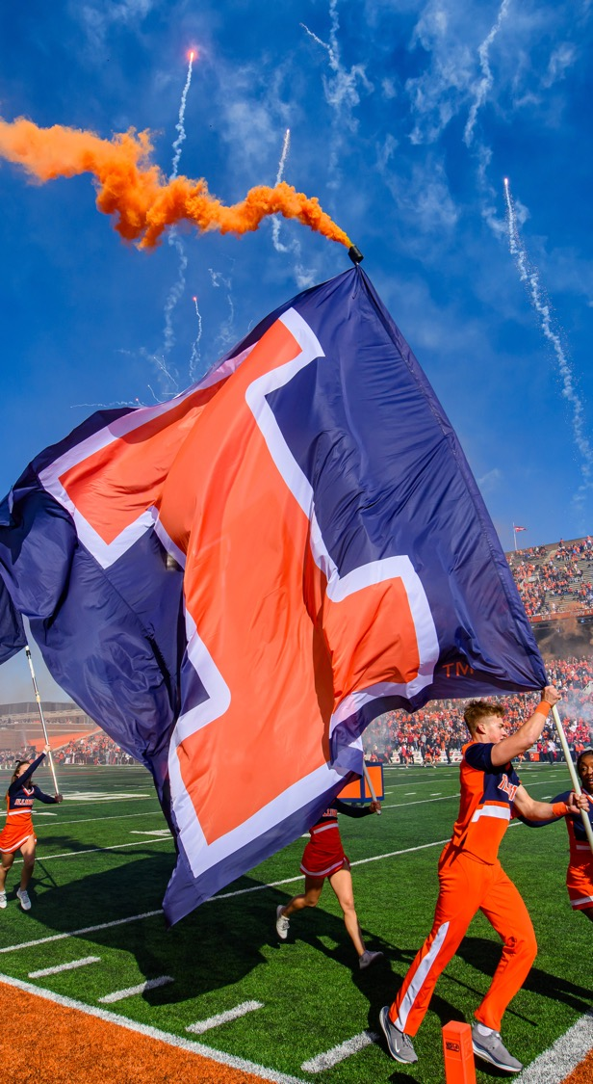
Overview with Image
Trust · Respect · Accountability · Integrity · Teamwork · Safety · Perseverance

Slide 3
Overview
Trust · Respect · Accountability · Integrity · Teamwork · Safety · Perseverance

Slide 4
Title and Content
Trust · Respect · Accountability · Integrity · Teamwork · Safety · Perseverance

Slide 5


Title and Content with bottom image
To easily change photo, Right-click and select change picture.

Slide 6
Subheadings with 2 columns
Trust · Respect · Accountability · Integrity · Teamwork · Safety · Perseverance

Slide 7
“Quote”
Trust · Respect · Accountability · Integrity · Teamwork · Safety · Perseverance

Slide 8
Title Only
Trust · Respect · Accountability · Integrity · Teamwork · Safety · Perseverance

Slide 9




Timeline
Trust · Respect · Accountability · Integrity · Teamwork · Safety · Perseverance

Slide 10
Bar Graph
Trust · Respect · Accountability · Integrity · Teamwork · Safety · Perseverance

Slide 11
Pie Chart
Note:
Patterns are recommended use for pie charts, as they help visually impaired readers differentiate between sections.
Trust · Respect · Accountability · Integrity · Teamwork · Safety · Perseverance

Slide 12





































Icon Set
Trust · Respect · Accountability · Integrity · Teamwork · Safety · Perseverance

