Slide 1
F&S Procurement Services Illinois Contract System (iCS) Kickoff 3/11/15
Presented by
Sonya Chambers
Maria Thompson

Slide 2
iCS User Guide, Quick Reference Card, & System Access available at: https://erin.fs.illinois.edu/Resources/business-tools

Slide 3
Agenda
iCS System Overview
Changes for You the Contract Approver
F&S iCS Approval Workflow
Next Steps

Slide 4
iCS System Overview
Intent
Familiarization instead of training
Why iCS?
Shift from a manual paper process to an electronic contract routing & approval process to increase:
Visibility
Tracking & Filing
Audit trail
Video: Web-based Training
Executive Approver
System Roles
Basic Navigation
My Tasks
Assign a Proxy
Reports
Search

Slide 5
Changes for You the Contract Approver

Slide 6
F&S iCS Approval Workflow
Excel Workflow
F&S Setup by Org Code
BUs will only see contracts assigned to respective org code
Contracts issued prior to F&S go live
Primarily filed under org 701
Will move them from 701 to correct org code
Urbana Contracts Office must move them
ProcSrvcs needs to identify to which org each should move
About 75-85 to review

Slide 7
Next Steps
F&S IT, Jim Brandt, will schedule a time with you to ensure your computer is properly setup
Receive “Welcome to iCS” email from the iCS team on 3/13/15
Will contain direct URL to iCS login and resource page
Please use ERIN instead
Go to ERIN, via Internet Explorer, to:
Test your access by logging into iCS using your Enterprise (EAS) credentials
Review the Quick Reference & User Guide Resources
Help link in iCS more detailed

Slide 8
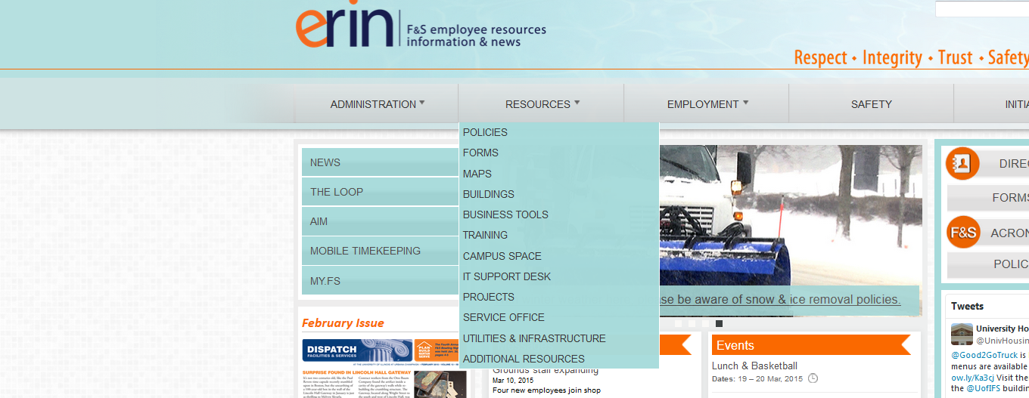
Next Steps

Slide 9
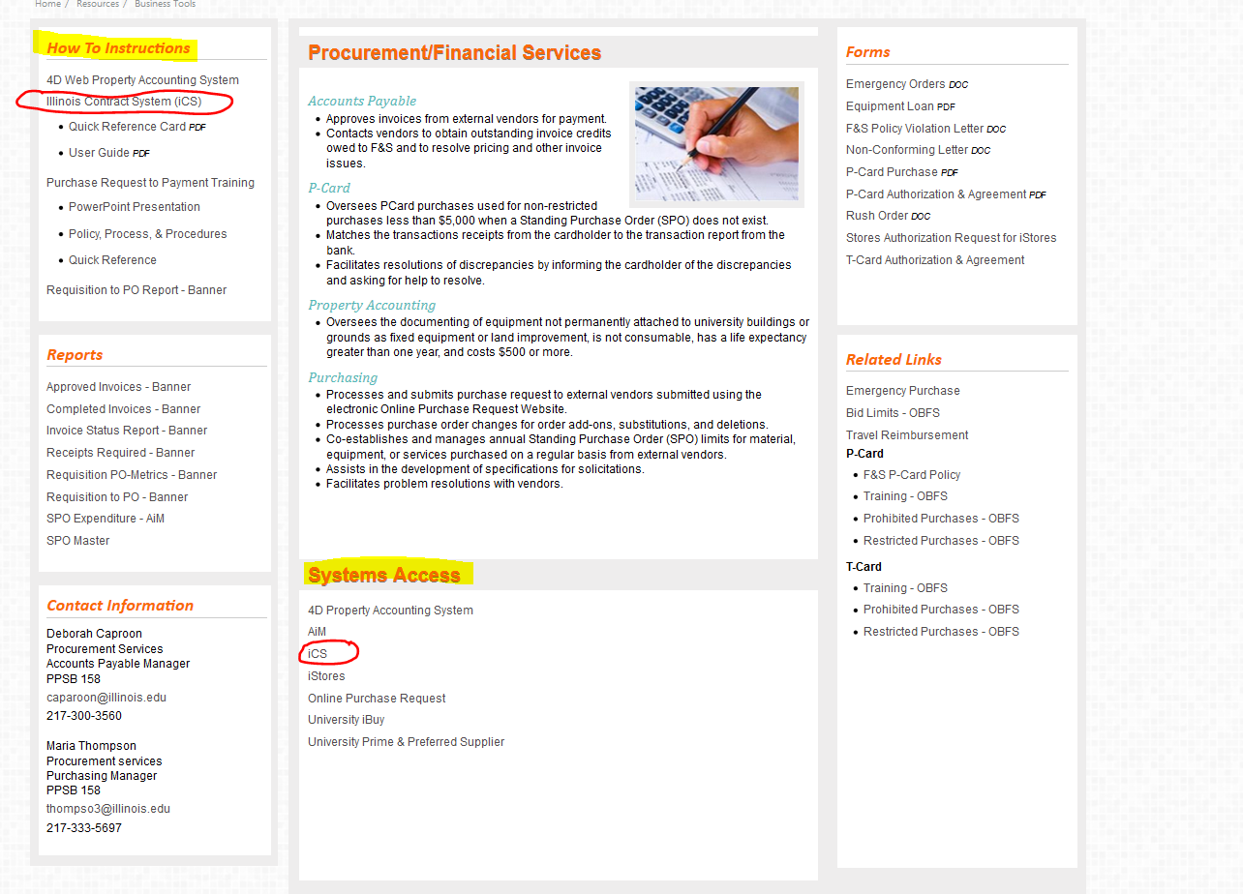
Next Steps

Slide 10
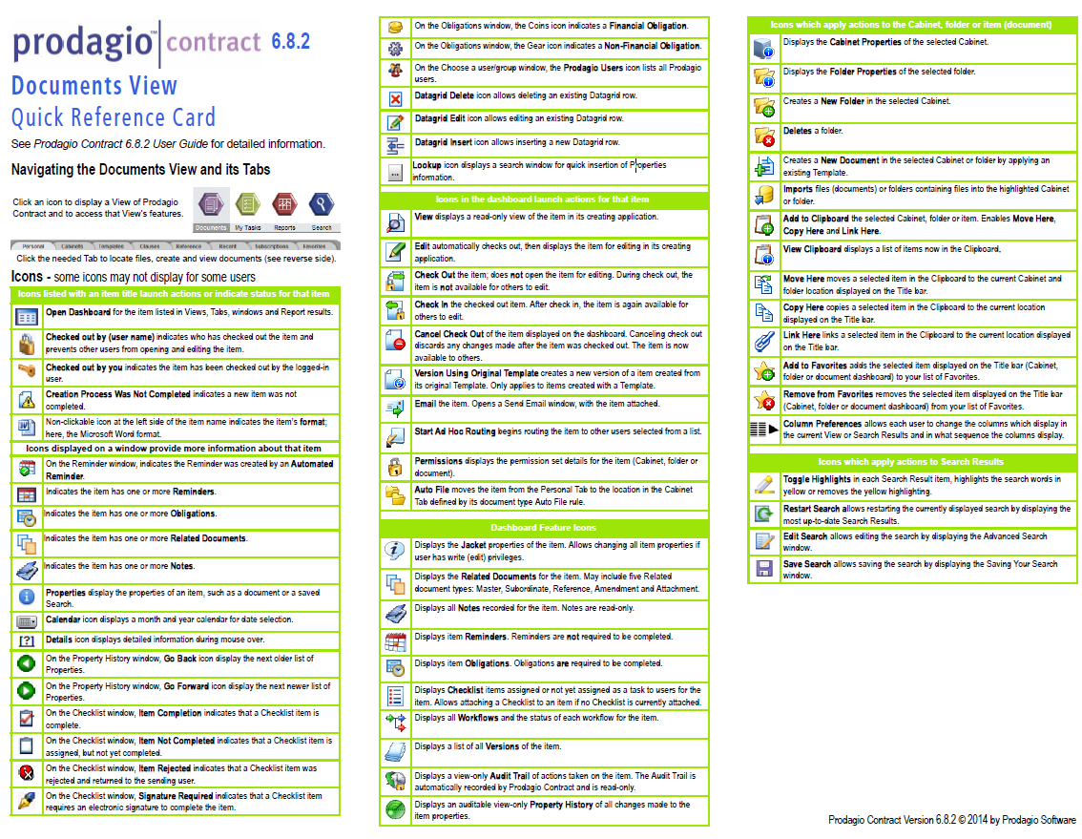
Next Steps

Slide 11
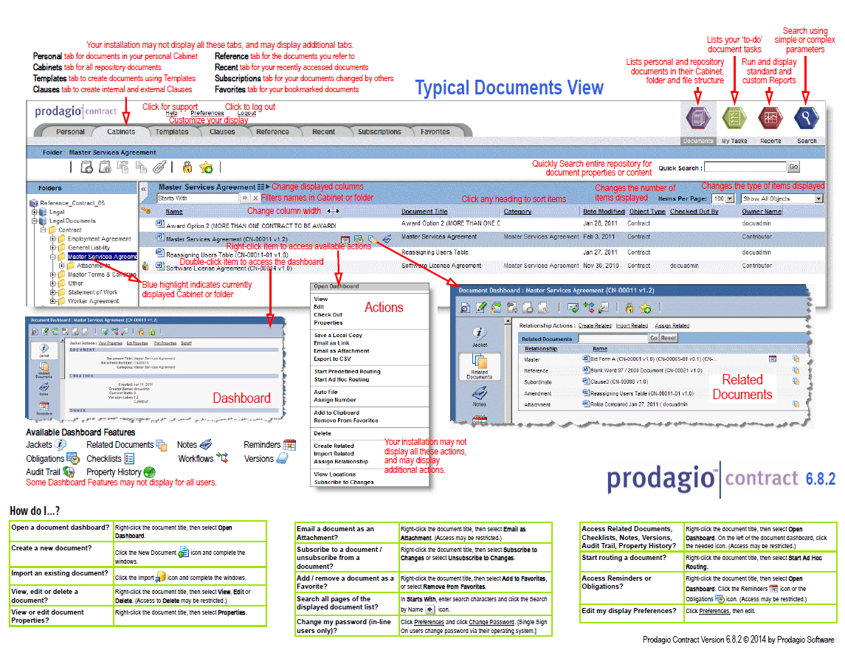
Next Steps

Slide 12
Agenda
iCS System Overview
Changes for You the Contract Approver
F&S iCS Approval Workflow
Next Steps

